Slide 1
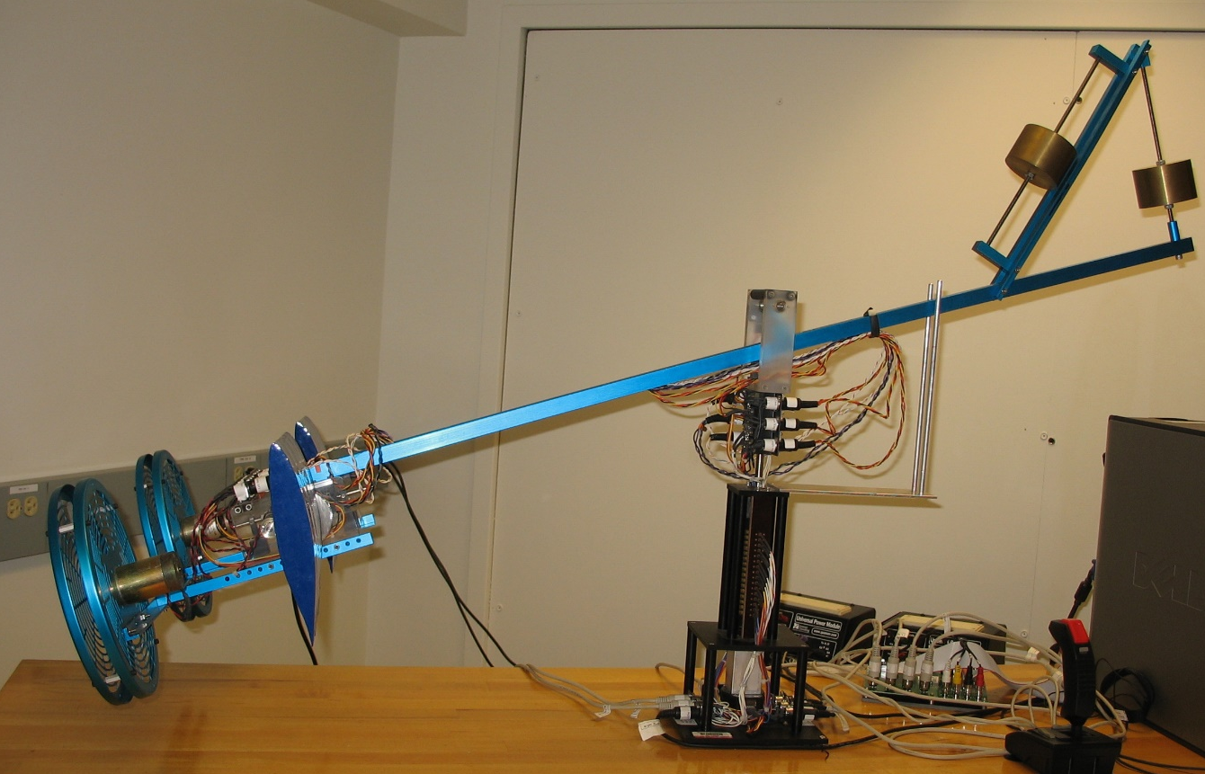
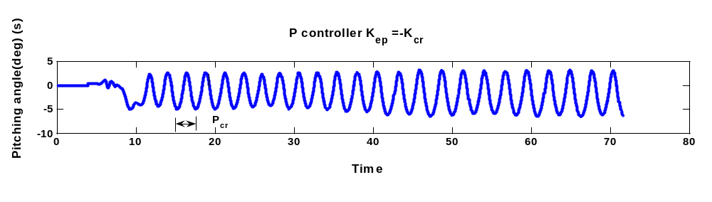
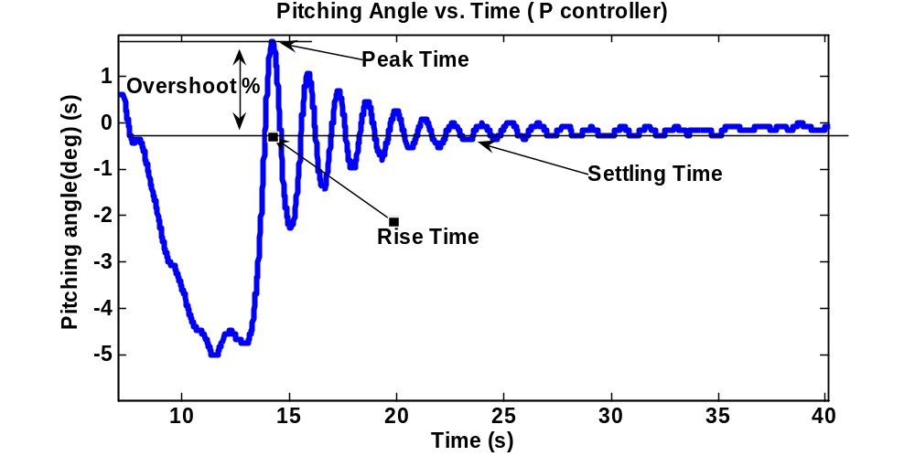
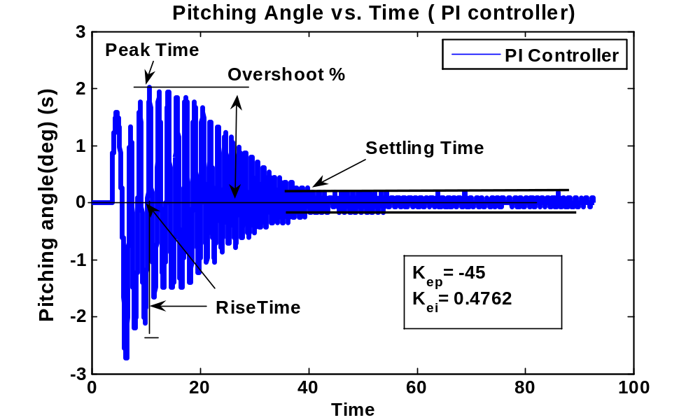
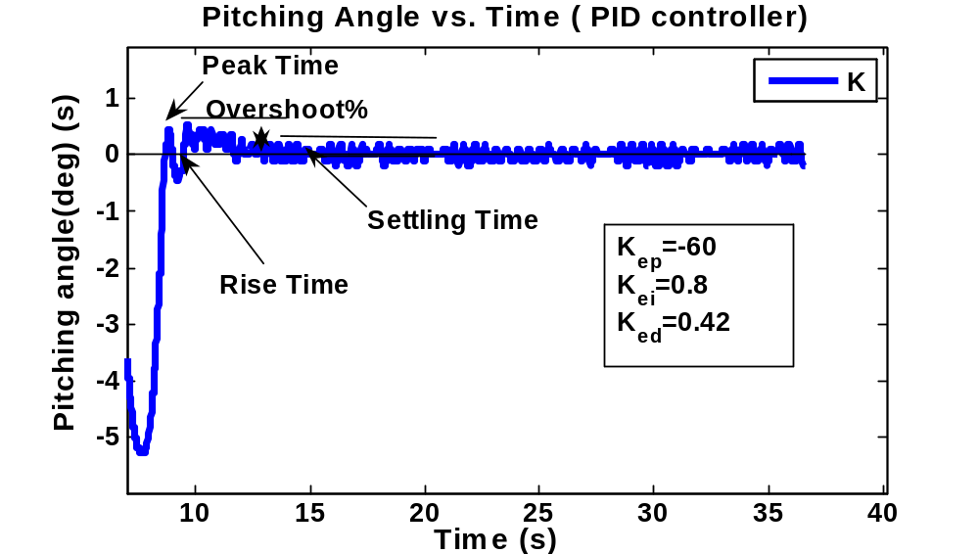
Design and Implementation and Testing of a PID Controller for a Model Aircraft
CL RESPONSE | RISE TIME | OVERSHOOT | SETTLING TIME | S-S ERROR
Kp | ↓ | ↑ | Δs | ↓
Ki | ↓ | ↑ | ↑ | ‰
Kd | Δs | ↓ | ↓ | Δs
Controller | Rise Time | Peak Time | Settling Time
P | 1.16s | .86s | 14.67s
PI | .58s | .97s | 31.03s
PID | 1.02s | 1.09s | 7.07s
ME403- Fall 2009

